Slide 1



StatPearls
Introduction to

Slide 2
What is StatPearls?
StatPearls provides exam review and self-testing resources. Subscribed packages: All Medical Specialties** Dental Package* National Board Dental Hygienist Examination (NBDHE)* Nurse Practitioner** Nursing Certification** Nursing NCLEX (RN and PN)** Pharmacy** Physician Assistant** USMLE Steps 1, 2, and 3**

Slide 3
How do you get to StatPearls?
Statpearls can be found in the list of Databases.
You must register first through the LSUHSC-New Orleans registration portal using this link: LSUHSC-New Orleans Registration Portal
Once you are registered, you can log in at the StatPearls website
https://www.lsuhsc.edu/library/databases/statpearls.aspx

Slide 4
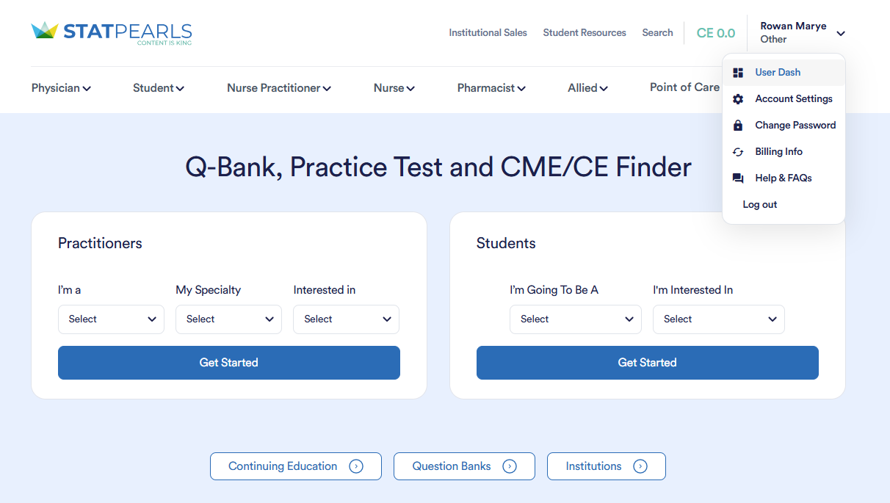
Navigating StatPearls
Notes:
When you log in, you will come to this landing page. Almost everything you want is accessed through “User Dash”

Slide 5
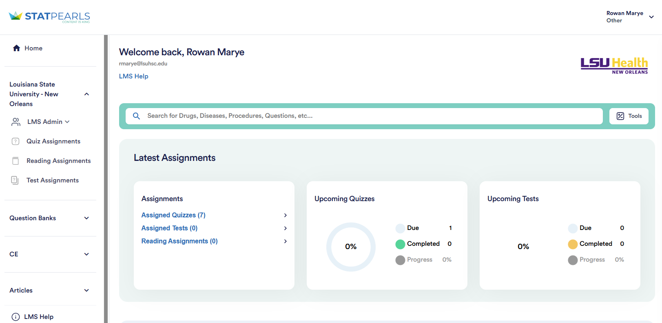
User Dash
The User Dash Is a quick overview of your account, focusing on upcoming quizzes and assignments.
It also includes a search that links to StatPearls overviews of various topics.
Below, you can find the self-test and continuing education resources.
Notes:
The interface is focused more on the student/test taker, so the first thing you see is quizzes that have been assigned to you.
To access administrative functions, click on LMS Admin.

Slide 6
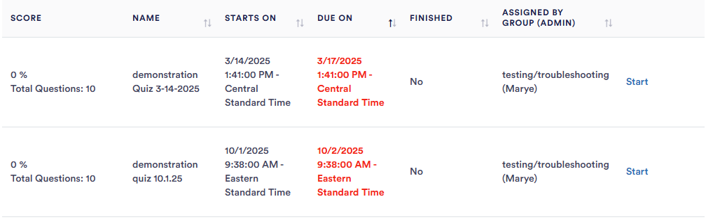
Take a Quiz
Click on “Assigned Quizzes” in the “Assignments” group to access your quizzes.
Uncompleted assignments appear in red.
Completed assignments will show a score and possibly the option to review results.

Slide 7
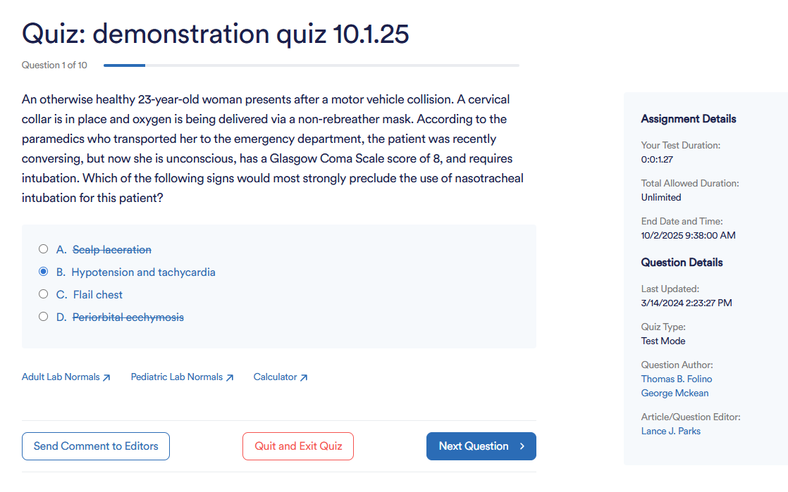
Tips for Quizzes:
Click on the text to mark out options before selecting your answer.
For untimed quizzes, you may exit and resume, but timed quizzes will count time from start of the quiz and won’t allow you to resume once the time has run out.

Slide 8
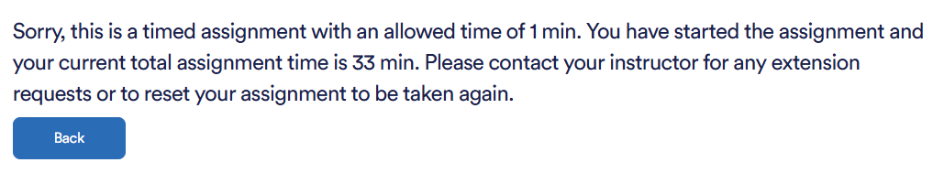
Out of Time?
If you run out of time during a quiz or try to complete it after the due date, you will see an error message like the one above. Please reach out to your instructor about extensions or re-takes (or if they may have set the wrong due date on the assignment).

Slide 9
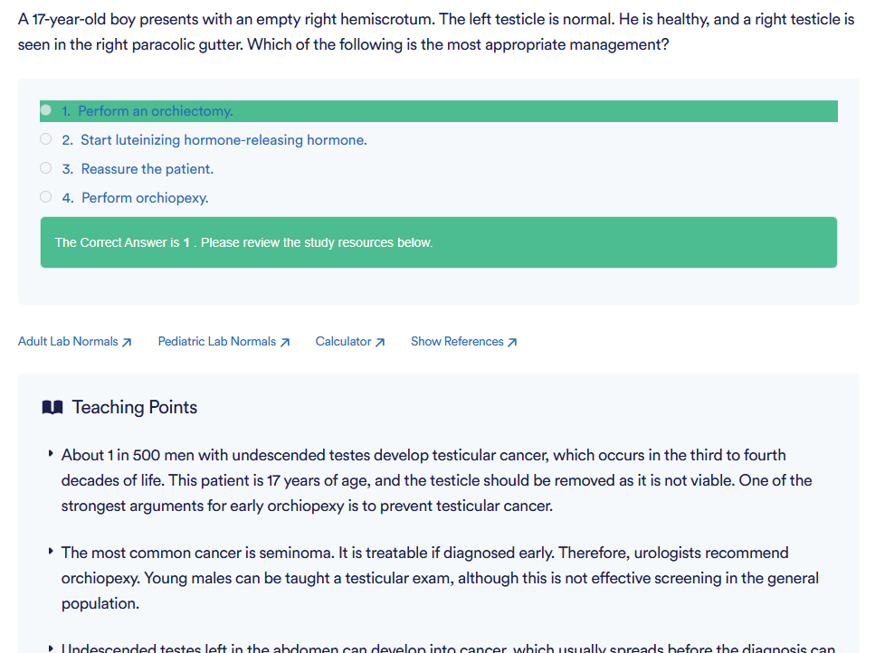
Viewing Results
If your instructor has allowed students to view results, you can see the questions you missed or failed to answer on assignments, as well as the correct answer and study resources.
Otherwise, you’ll just see a percent right/wrong.

Slide 10
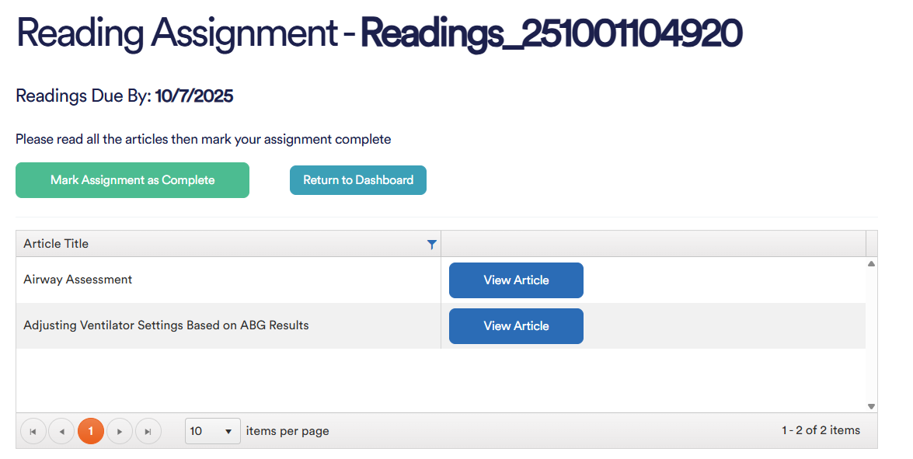
Reading Assignments
Access assigned articles by clicking on the assignment, the on “View Article.” Mark Assignment as Complete when finished.

Slide 11
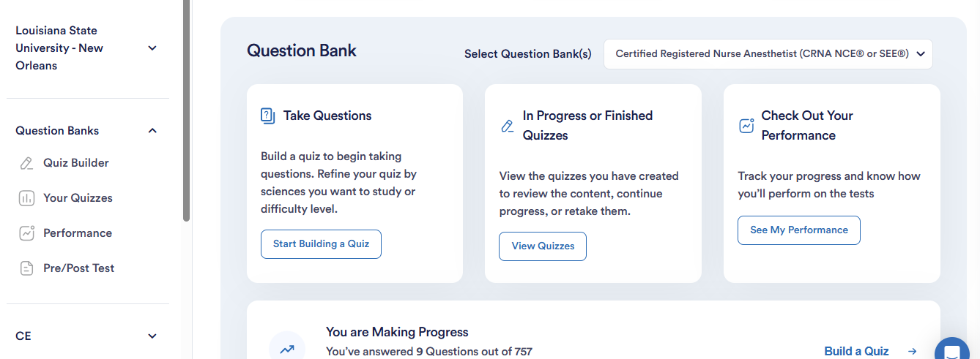
Creating a Quiz
Go to Question Bank to build a quiz for self-study. You can access this in two places:

Slide 12
Quiz Options
Select from a wide range of question banks.
Choose between “Study” and “Test” modes.
  Study Mode: shows teaching points and feedback on incorrect answers.
  Test Mode: answer all questions and review at the end.
Select Difficulty Level and Age Range as desired.
Narrow to specific topics.
Choose number of questions for your quiz.
Select “Create and Take Quiz” when done.
Quiz will start immediately but will also appear in your created quizzes to complete at a later time.

Slide 13
Track your progress
You can see performance data such as correct and incorrect answers and a comparison to other users of the question bank.
Pre and Post Tests based on your specialty allow you to compare your performance before and after.

Slide 14
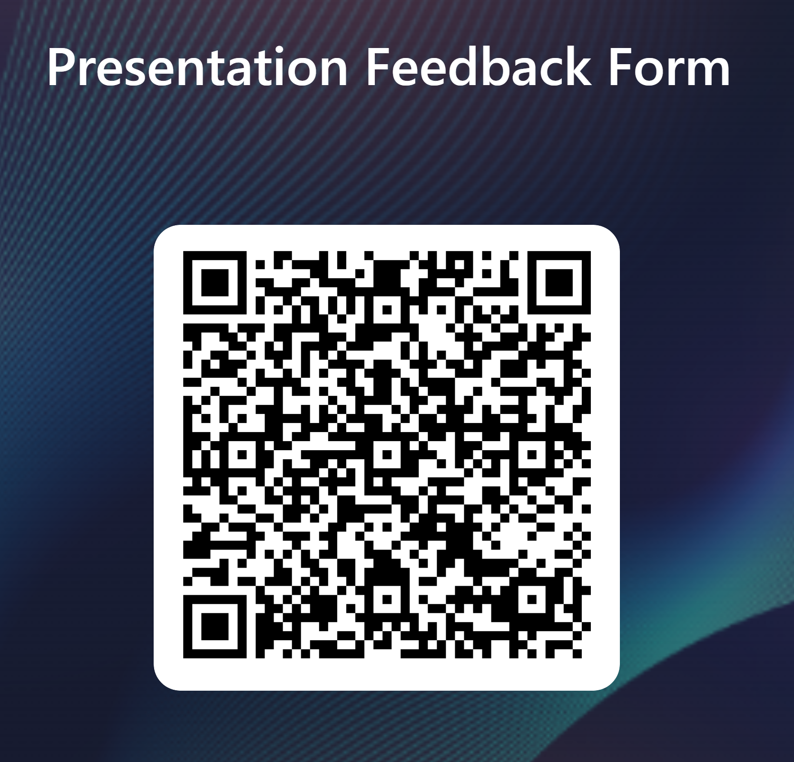
THANK YOU!
Rowan Marye
Public Services Librarian
Nursing Liaison
rmarye@lsuhsc.edu
504-568-6100

